Slide 1
Employee Retention Credit Overview

Slide 2
We allow businesses to apply online to determine their eligibility for the Employee Retention Credit (ERC) at no cost
Who is
Recovery Profit Systems and our Back-end Partners are a consulting and technology company: we get to know the client, confirm their eligibility prior to having them sign a contract and requesting a deposit to finalize their project
Industry-leading speed: Once we receive all the required date, we can complete a project, which includes amending their 941-x in 5 business days or less
Willing to work with groups as small as 5 employees
Headquartered in Atlanta, GA
We agree to assist our clients to any IRS notices regarding ERC credits claimed and/or a related audit and to provide any and all requested documentation as part of such audit.

Slide 3
Refresher: What is the ERC?
“ERC” stands for Employee Retention Credit
Created by the CARES Act, signed into law on 3/27/2020
COVID-19 economic stimulus program
Originally, businesses had to choose between Paycheck Protection and Employee Retention Credit
On 3/1/2021, the IRS released Noticed 2021-21, which updated the guidance to:
A) allow businesses to participate in both the PPP and ERC
B) do so retroactively, going back to 3/12/2020 3/1/2021, the IRS released Noticed 2021-21, which updated the guidance to:
On 8/1/2021, the IRS expanded the definition of an eligible employer to include “Recovery Startup Business”

Slide 4
Tell me more…
Called a “tax credit” but can be received as a cash payment from the IRS/US Treasury
There is no dollar limit on the amount a business can receive; there are no requirements on how the money must be spent
Originally just applied to 2020; however, the American Rescue Plan Act (ARPA) extended the program into 2021
Interacts with PPP: every dollar of wages can potentially be used for either program, but not both; there is a specific methodology to optimize between the two programs
The program requires a knowledge of the client, the unique details of how it was impacted by COVID-19, and a lot of payroll details – meaning this a niche that is difficult for any existing provider to fill

Slide 5
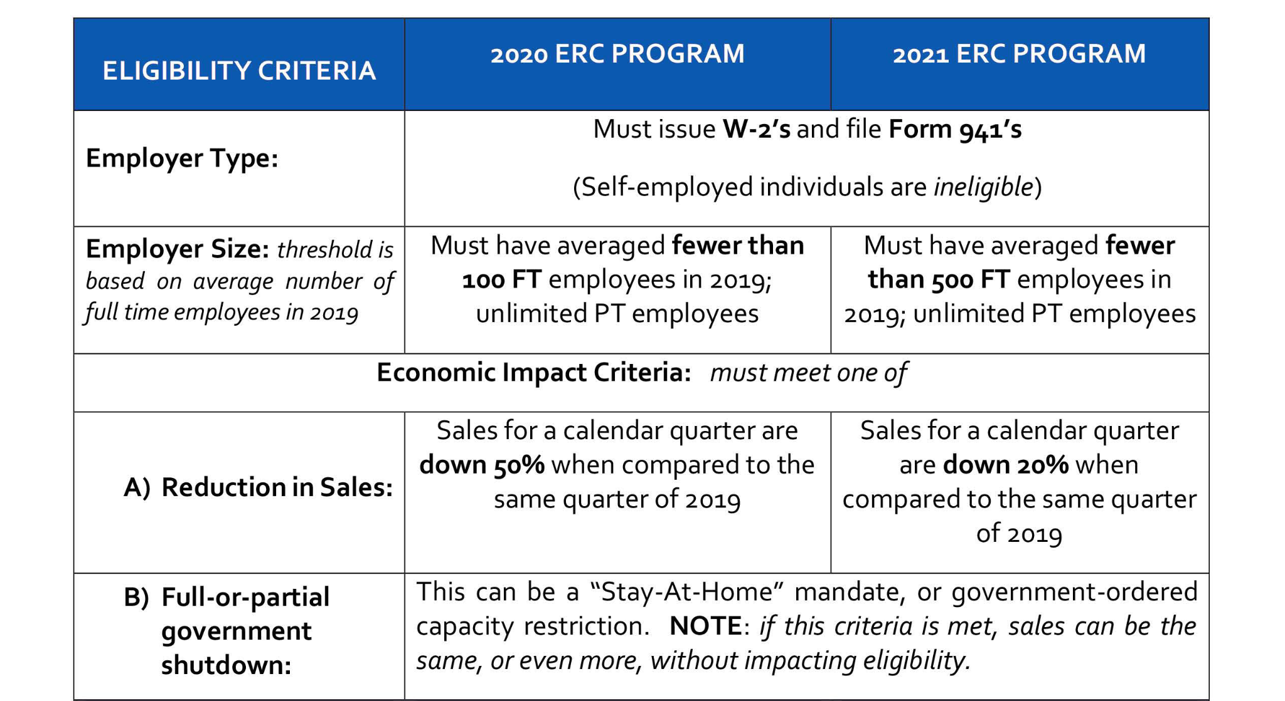
Who Qualifies?

Slide 6
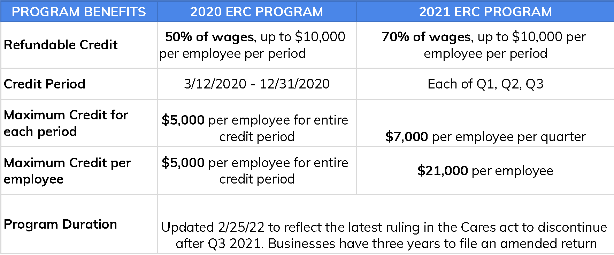
Client Financial Opportunity

Slide 7
Recovery Startup Business
New Business that began operations on or after 2/15/2020 & average under $1 million dollar in annual gross receipts qualify
Must have 1 or more employees and pay them during Q3 & Q4
A purchased (existing) business that was open on or after 2/15/2020 does not qualify
Eligible to receive up to $7k per employee per quarter, capped at $50k per quarter in Q3 & Q4 of 2021
Receive up to 70% of 10k in Wages per employee per quarter (Q3 & Q4)
We recommend you monitor your gross receipts to ensure your business is under the $1 million dollar threshold for 2020 & 2021 and file for the ERC after Q3 & Q4 of 2021 to claim the credits

Slide 8
Take Action Now! Brought to you by https://top3seocompany.com
Go to https://toprecoveryfunding.com
Fill out the simple questionnaire
Our team will pre-qualify you
You will be notified for final steps
It’s Your Money – Get It.

